Slide 1

Time-Series Foundation Models (TSFM)
In Finance

Slide 2
Agenda
Summary
Why is time-series forecasting important? (slide3)
Why is there a need for another way of doing time-series forecasting? (slide4)
What is the solution to the previous question? – Answer: (slide 4)
What are TSFMs? (slide 5)
Which are the best / most popular TSFMs? (slides 6 and 7)
HOW are we going to figure out if they are useful in Finance? (slide 8)
How do we evaluate time-series forecasting performance? (slide 9)
What do we compare TSFMs with? (slide 10)
How do we set up the experiment? (slide 11)
What have we done so far? (slides 12 and 13)
What should we do in the future? (slides 14 and 15)
What does the future schedule look like? (slides 16 and 17)

Slide 3

Do TSFMs outperform traditional time-series prediction models in the field of finance?
comprehensive study on state-of-the-art Tsfm performance on financial datasets

Slide 4
Summary
Why need for changing the time-series forecasting paradigm?
What is the solution? Answer: TSFMs!
How do we find out whether TSFMs are effective ?
TSFMs are:
Already pre-trained on large amounts of time-series data
Reducing the need for proprietary data collection, cleaning, storage, etc…
Simple and ready to use
Reducing the need for complex ML pipelines and large ML teams to build and maintain them
Flexible
Having the ability to be fine-tuned in special cases
Proven effective
Reliable and accurate
Steps:
Models’ performance needs to be measured
This is done using regression metrics
We need to make sure that the evaluation is statistically significant
This is done by employing Time Series Cross Validation (TSCV)
We need to compare the TSFM against a benchmark
Benchmark are the traditional time-series prediction models
Time-series forecasting is
Hard
Building ML pipelines for time-series forecasting models requires specialized expert knowledge
ML models can be 100s of lines of code, and require vast amounts of data to train
Confusing
It’s easy to get lost and oversee mistakes in the code
We often don’t know why models make forecasts that they do
Expensive
Getting the data and employing staff to maintain the ML pipeline requires a lot of resources

Slide 5
Time series forecasting
Financial planning and budgeting
Risk management
Strategic decision-making
Enables decision-makers to prepare for the future

Slide 6

Time-series foundation models
Standard Time-serieS, transformer-based, self-supervised, generative

Slide 7
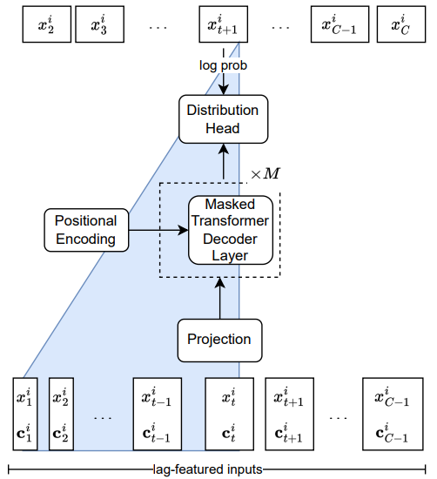
Lag llama
2,449,299 parameters
Trained on 27 time-series datasets (352m tokens / 7,965 univariate time-series)
Fine tuning capabilities
Univariate time-series forecasting without exogenous variables

Slide 8
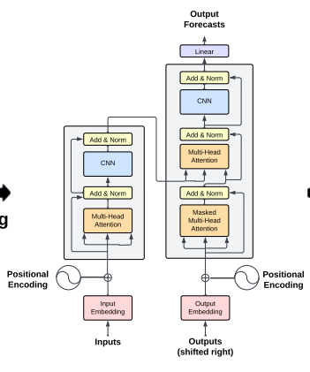
Time gpt
??? parameters
Trained on 100b data-points
Fine tuning capabilities
Anomaly detection
Multivariate time-series forecasting with exogenous variables

Slide 9

Methodology
Evaluation, Benchmark and experiment parameters

Slide 10
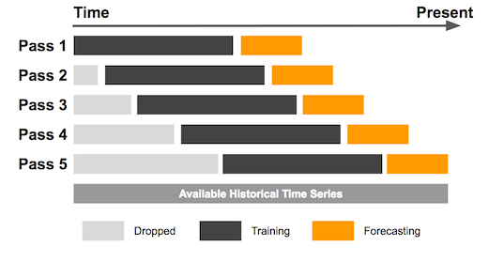
evaluation
Models’ performance will be measured using the following metrics:
Statistical significance of the measurements will be ensured using K-fold Time Series Cross Validation:
RMSE
R2
MAPE
MDA

Slide 11
Benchmark
autoARIMA
Prophet
Autoregressor
ARIMA model with automatic hyperparameter (P, I, Q) selection
AR (Autoregressive) component of the model approximates the linear relationship between the previous P datapoints and the future prediction
I (Integrated) component tests the stationarity of the data and transforms the data to stationary form
MA (Moving Average) component approximates the linear relationship between the prediction and Q-period moving average of the time-series
Generalized Additive model (GAM)
Works well with non-linear trends, seasonality and holiday effects
Robust to missing data and shifts in the trends
Handles the outliers well
Widely used
Built by Facebook (Meta)
Linear regression of the future value on only one previous value
Simple but proved quite effective for stock market price predictions

Slide 12
Experiment parameters
Stock prices
Stock returns
Volatility
Trading volumes
Interest rates
Exchange rates
Commodity prices
Type of data
Frequency of data
Context length and training size
Exogenous variables
Periods of different Economic conditions
Forecast horizon (n periods)
Minutely
Hourly
Daily
Monthly
Quarterly
The Experiment is to be run in every possible configuration according to each possible combination of the outlined parameters
L = 32, 64, 128, …, 1024
No
Yes (Which?)
Stable
Inflation
One
More than one

Slide 13

Initial Results

Slide 15

Next steps

